Slide 1
Process Synchronization

Slide 2
Common Synchronization Problems
Race Condition: A race condition occurs when two or more processes (or threads) access shared data simultaneously and the outcome depends on the order of execution.
Deadlock: Deadlock occurs when two or more processes are each waiting for the other to release a resource, causing the system to freeze.
Starvation: happens when a process is perpetually denied access to a resource because other processes are continuously favored

Slide 3
Producer Consumer Problem

Slide 4
Before Starting an explanation of code, first, understand the few terms used in the above code:
"in" used in a producer code represent the next empty buffer
"out" used in consumer code represent first filled buffer
count keeps the count number of elements in the buffer
count is further divided into 3 lines code represented in the block in both the producer and consumer code.

Slide 5
Producer Consumer Problem Cont.
int count = 0; void producer(void) { int itemP; while(1) { Produce_item(item P) while(count == n); buffer[in] = item P; in = (in + 1)mod n count = count + 1; } }
Memory Management Load Rp, m[count] Increment Rp Store m[count], Rp
Producer Code
If we talk about Producer code first:
--Rp is a register which keeps the value of m[count]
--Rp is incremented (As element has been added to buffer)
--an Incremented value of Rp is stored back to m[count]

Slide 6
Producer Consumer Problem Cont.
int count; void consumer(void) { int itemC; while(1) { while(count == 0); itemC = buffer[ out]; out = (out + 1) mod n; count = count - 1; } }
Memory Management Load Rc, m[count] Decrement Rc Store m[count], Rc
Consumer Code
Similarly, if we talk about Consumer code next:
--Rc is a register which keeps the value of m[count]
--Rc is decremented (As element has been removed out of buffer)
--the decremented value of Rc is stored back to m[count].

Slide 7
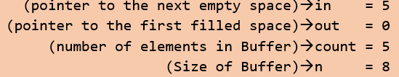
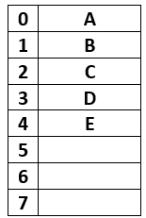
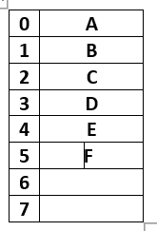
Let's start with the producer who wanted to produce an element " F "
Buffer[in] = itemP → Buffer[5] = F. ( F is inserted now)
in = (in + 1) mod n → (5 + 1)mod 8→ 6, therefore in = 6; (next empty buffer)

Slide 8
Suppose just after Increment and before the execution of third line (store m[count], Rp) Context Switch occurs and code jumps to consumer code. .

Slide 9
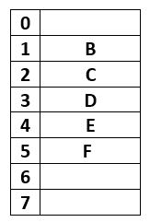
Now starting consumer who wanted to consume the first element " A "
After removal of A, Buffer look like this
Where out = 1, and in = 6
itemC = Buffer[out]→ itemC = A ( since out is 0)
out = (out + 1) mod n → (0 + 1)mod 8→ 1, therefore out = 1( first filled position)

Slide 10
Since count = count - 1; is divided into three parts:
Load Rc, m[count] → will copy count value which is 5 to register Rp.
Decrement Rc → will decrement Rc to 4.
store m[count], Rc → count = 4.
Now the current value of count is 4

Slide 11
Suppose after this Context Switch occurs back to the leftover part of producer code. . .
Now the current value of count is 6, which is wrong as Buffer has only 5 elements, this condition is known as Race Condition and Problem is Producer-Consumer Problem.
Race Condition: A race condition occurs when multiple processes (or threads) access shared data in an unpredictable manner, causing the system to reach an incorrect or inconsistent state. In this case, the producer has incremented count without actually updating the buffer, and when the context switch happens, the count value is mistakenly updated to 6, even though only 5 items have been added to the buffer.

Slide 12
Semaphores…

Slide 13
A semaphore is an integer variable, shared among multiple processes. The main aim of using a semaphore is process synchronization and access control for a common resource in a concurrent environment.
function signal(S):
// This function represents the 'signal' or 'release' operation for a semaphore.
if there are processes sleeping on S:
// Wake up a blocked process
select a process to wake up
wake up the selected process
return
else:
// No process is waiting on S
S <- S + 1
return
function wait(S):
// This function represents the 'wait' operation for a semaphore.
if S > 0:
// Do not block the process
S <- S - 1
return
else:
// Block the calling process
sleep

Slide 14
There are two types of semaphores:
Binary semaphore
Counting Semaphore
A binary semaphore can have only two integer values: 0 or 1. It’s simpler to implement and provides mutual exclusion. We can use a binary semaphore to solve the critical section problem.
Some experienced readers might confuse binary semaphores with a mutex. There’s a common misconception that they can be used interchangeably. But in fact, a semaphore is a signaling mechanism where on the other hand, a mutex is a locking mechanism. So, we need to know that binary semaphore is not a mutex.

Slide 15
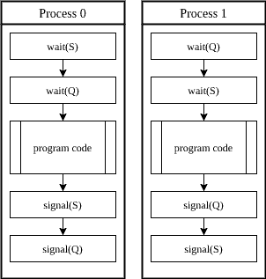
A deadlock occurs when a group of processes is blocked in a state waiting for some other member’s action.
To avoid possible deadlocks, we need to be careful about how we implement the semaphores

Slide 16
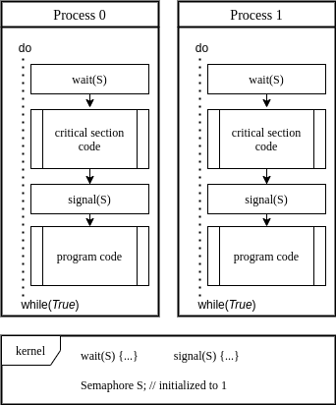
In the above example, we guarantee mutual exclusion in critical section access.
Instead of busy waiting, the waiting process is sleeping as it’s waiting for its turn on the critical section.
Then the signal operation is performed, kernel adds a sleeping process to the ready queue. If the kernel decides to run the process, it will continue into the critical section.

Slide 17
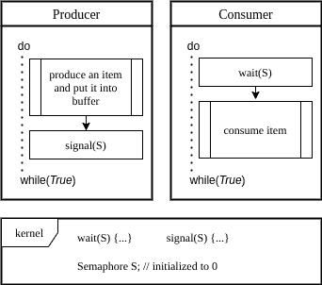
Initially, . As the producer puts an item into the buffer, it increases the semaphore by a signal operation. On the contrary, when the consumer consumes an item, by wait operation, the semaphore is decreased.
When a consumer uses the last item in the buffer, it’s put to sleep by the last wait operation.

Slide 18
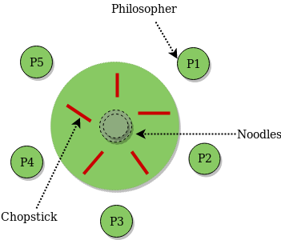
Dining Philosopher Problem Using Semaphores

Slide 19
Each Process is represented by:
process P[i]
while true do
{
THINK;
PICKUP(CHOPSTICK[i], CHOPSTICK[i+1 mod 5]);
EAT;
PUTDOWN(CHOPSTICK[i], CHOPSTICK[i+1 mod 5])
}

Slide 20
Var successful: boolean;
repeat
successful:= false;
while (not successful)
if both forks are available then
lift the forks one at a time;
successful:= true;
if successful = false
then
block(Pi);
{eat}
put down both forks;
if left neighbor is waiting for his right fork
then
activate (left neighbor);
if right neighbor is waiting for his left fork
then
activate( right neighbor);
{think}
forever

Slide 21
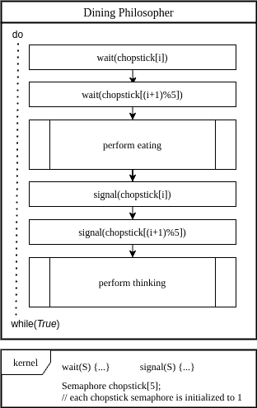
In this solution, when philosopher decides to eat, it first waits on semaphore . Then after acquiring it, the philosopher waits on semaphore . When both chopsticks are acquired, it can eat.
When the philosopher is full, it releases the chopsticks in the same order, by calling the signal operation on the respective semaphore.

Slide 22
One common solution to the Dining Philosopher Problem uses semaphores, a synchronization mechanism that can be used to control access to shared resources.
In this solution, each fork is represented by a semaphore, and a philosopher must acquire both the semaphore for the fork to their left and the semaphore for the fork to their right before they can begin eating.
If a philosopher cannot acquire both semaphores, they must wait until they become available.

Slide 23
semaphores forks[n] = {1, 1, 1, ..., 1}; // All forks are available initially
mutex := Semaphore(1); // Mutex for critical section
procedure philosopher(i: integer):
repeat
think(); // Philosopher is thinking
wait(mutex); // Enter critical section to pick up forks
wait(forks[i]); // Try to pick up left fork
wait(forks[(i+1)%n]); // Try to pick up right fork
signal(mutex); // Exit critical section
eat(); // Philosopher eats
signal(forks[i]); // Put down left fork
signal(forks[(i+1)%n]); // Put down right fork
until false;

Slide 24
The steps for the Dining Philosopher Problem solution using semaphores are as follows
Initialize the semaphores for each fork to 1 (indicating that they are available).
Initialize a binary semaphore (mutex) to 1 to ensure that only one philosopher can attempt to pick up a fork at a time.
For each philosopher process, create a separate thread that executes the following code:
While true:
Think for a random amount of time.
Acquire the mutex semaphore to ensure that only one philosopher can attempt to pick up a fork at a time.
Attempt to acquire the semaphore for the fork to the left.
If successful, attempt to acquire the semaphore for the fork to the right.
If both forks are acquired successfully, eat for a random amount of time and then release both semaphores.
If not successful in acquiring both forks, release the semaphore for the fork to the left (if acquired) and then release the mutex semaphore and go back to thinking.

Slide 25
4. Run the philosopher threads concurrently.
By using semaphores to control access to the forks, the Dining Philosopher Problem can be solved in a way that avoids deadlock and starvation. The use of the mutex semaphore ensures that only one philosopher can attempt to pick up a fork at a time, while the use of the fork semaphores ensures that a philosopher can only eat if both forks are available.

